Slide 1
CORAL Online Summit 2022
Making the Most of the Management and Organization Modules
By Sarah Dennis

Slide 2
Learning Goals
Maximize usage of Management Module.
Increase knowledge and usage of Organization Module.

Slide 3
CORAL’s Management Module
What are you using your Management Module for?
Examples of the docs we use in our Management Module.

Slide 4
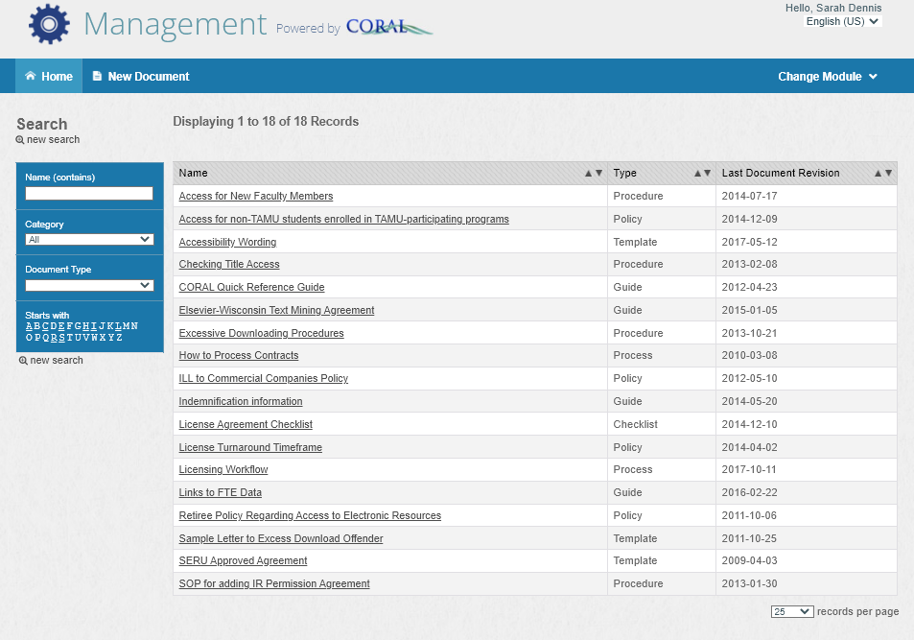

Slide 5
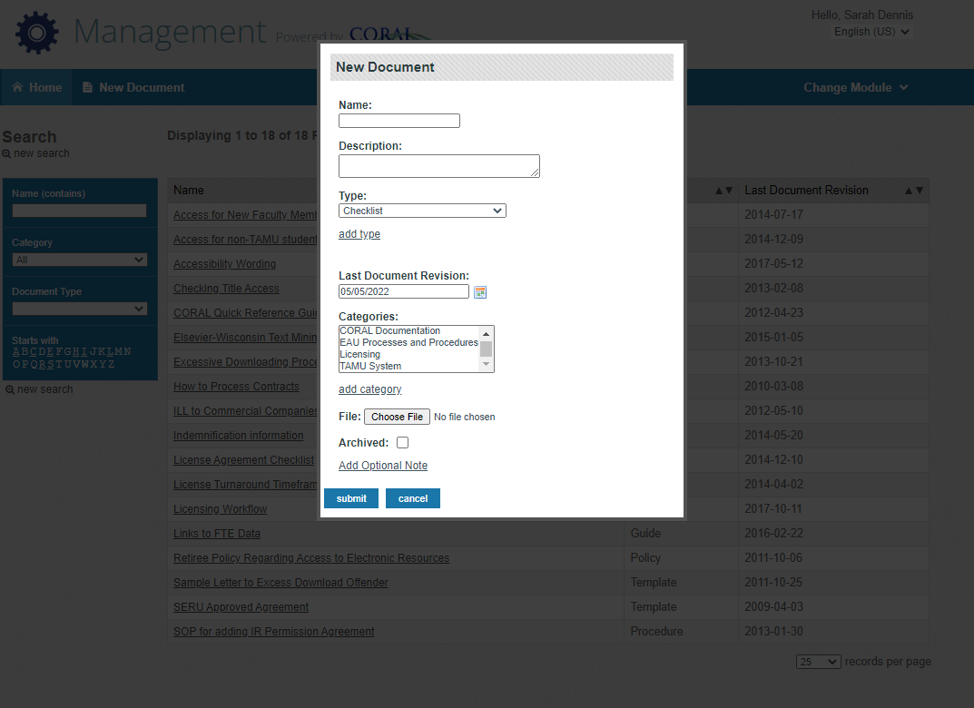

Slide 6
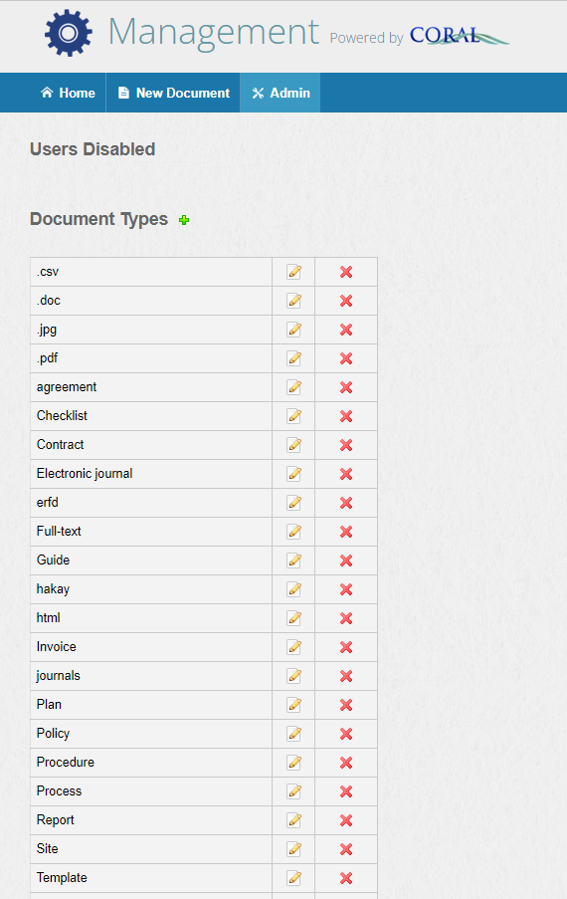
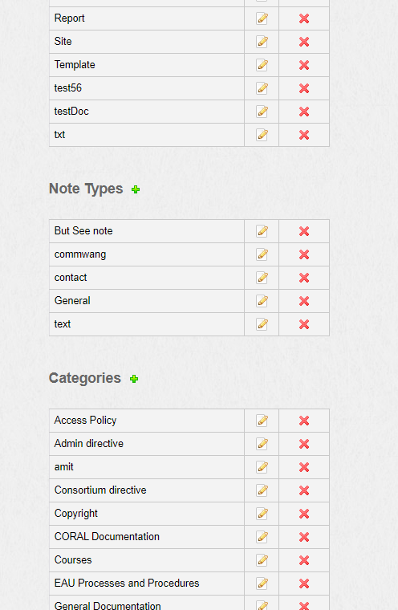

Slide 7
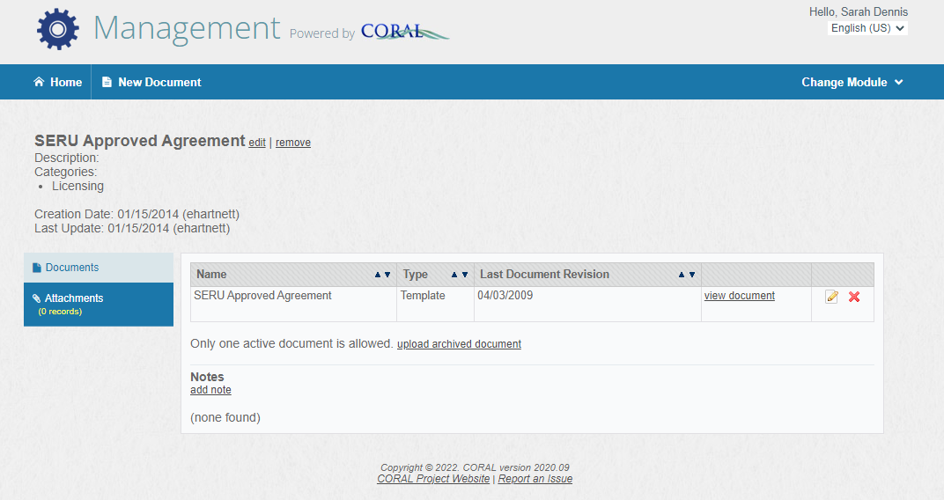

Slide 8
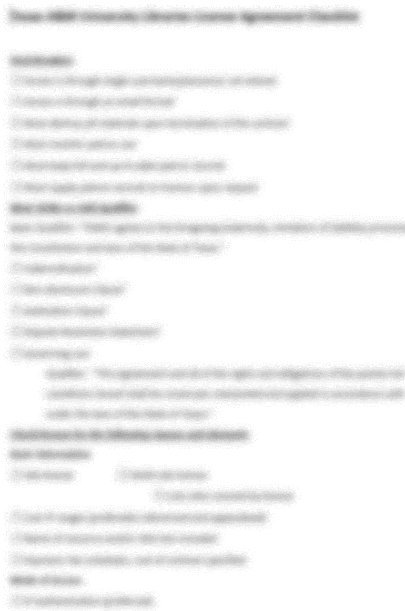
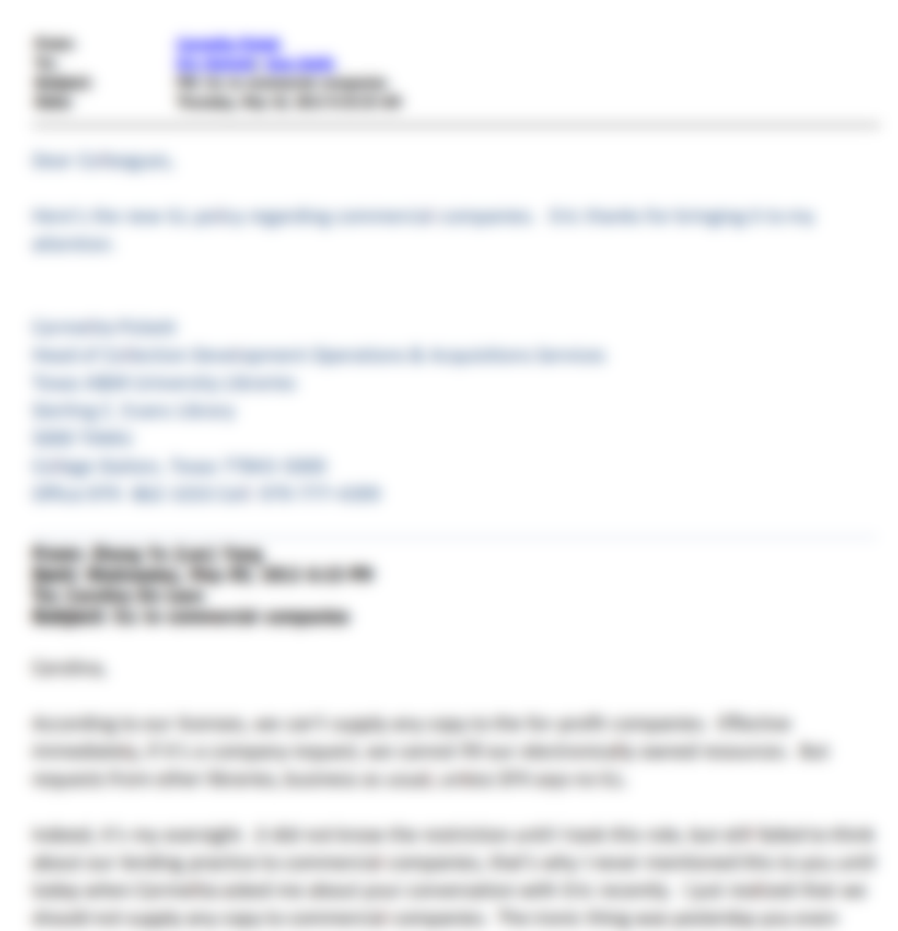
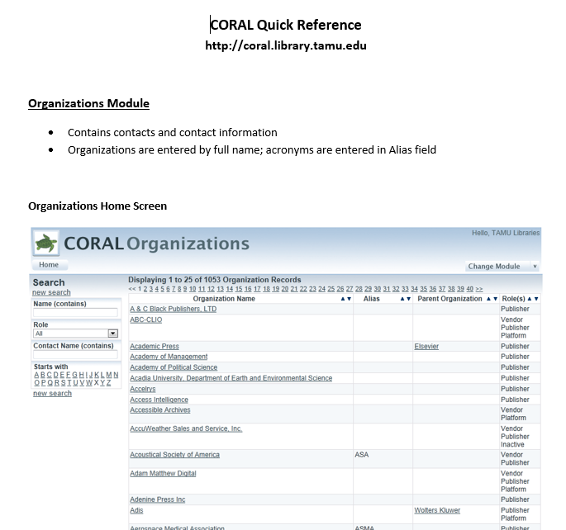
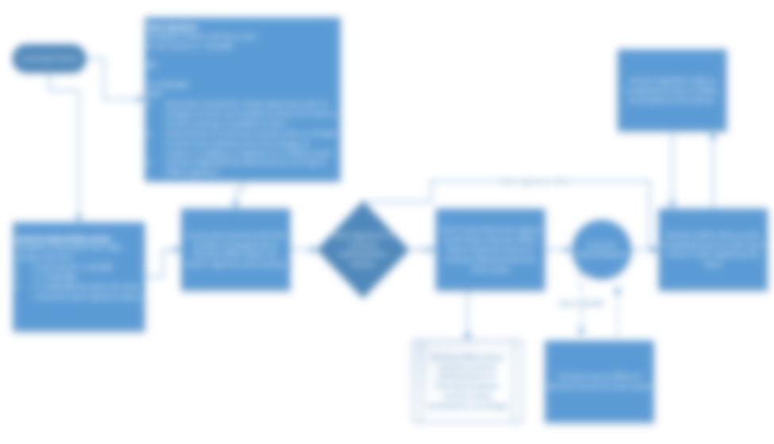
Onboarding Documentation
Licensing Checklists
Workflows
Guides
Policies

Slide 9
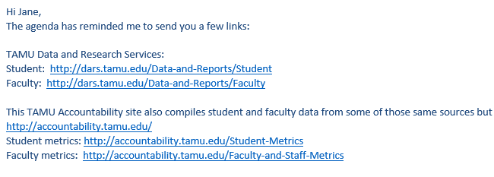
Documents to Ease Workflow
Link to FTE
Logo Information
Text templates

Slide 10
CORAL’s Organization Module
Parent - Child Relationships
Contacts Information
University Information

Slide 11
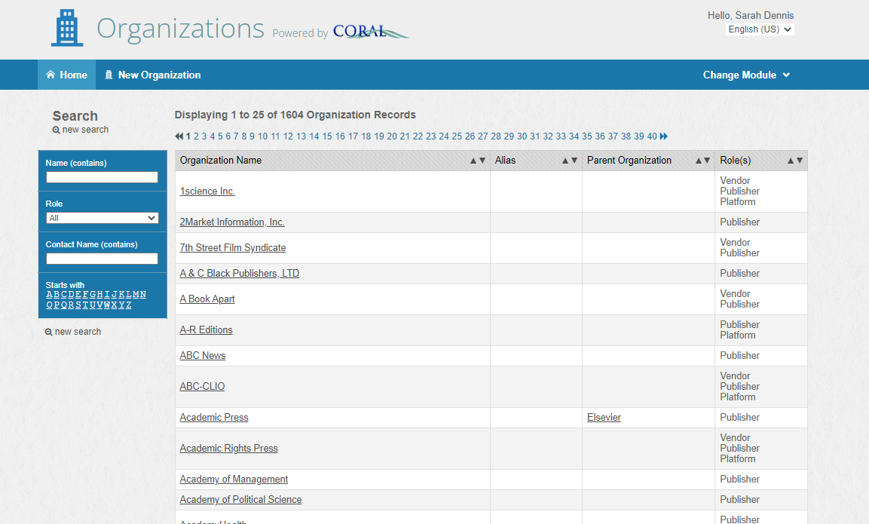

Slide 12
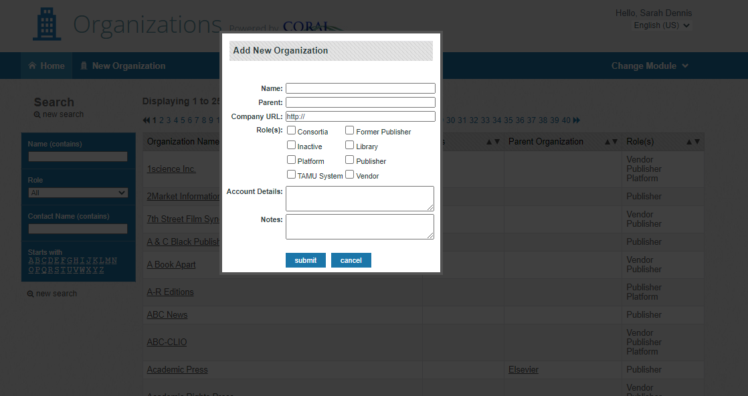

Slide 13
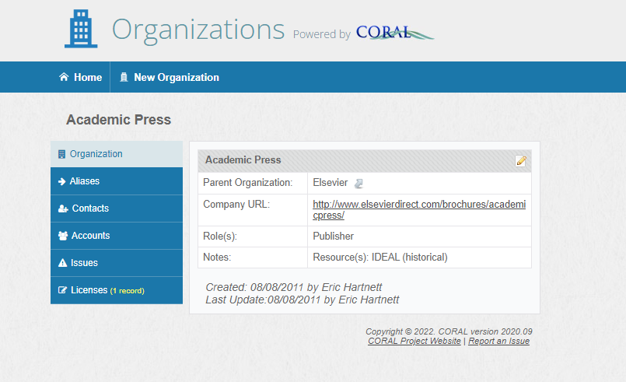

Slide 15
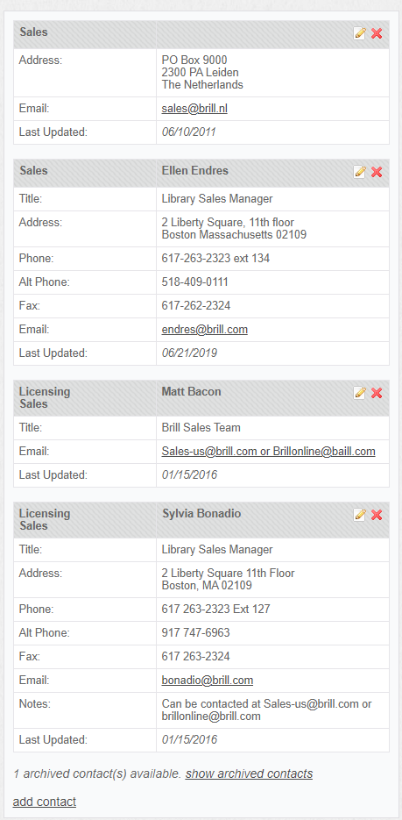
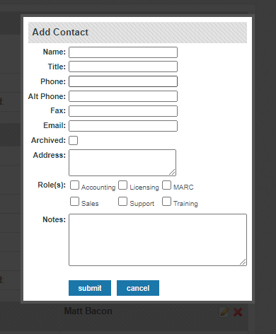

Slide 16
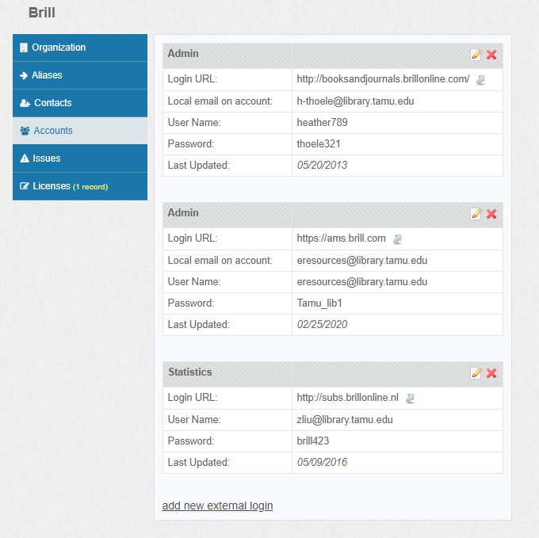
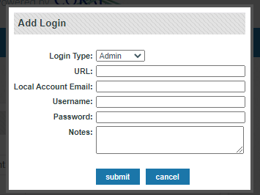

Slide 17
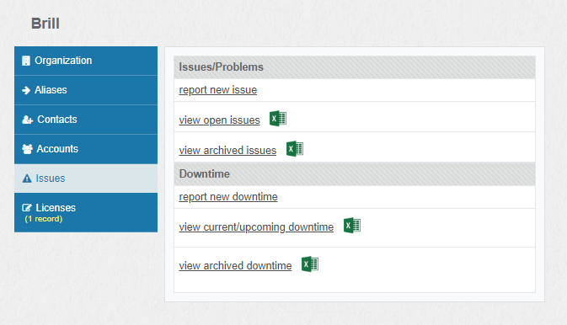

Slide 18
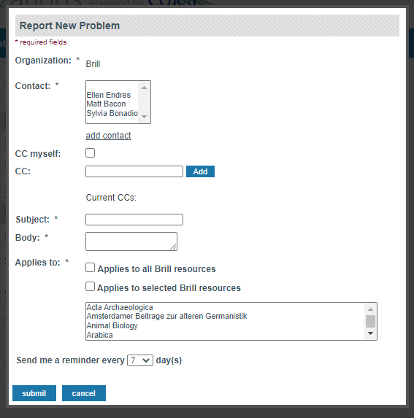
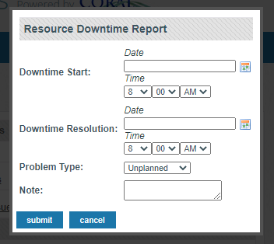

Slide 19
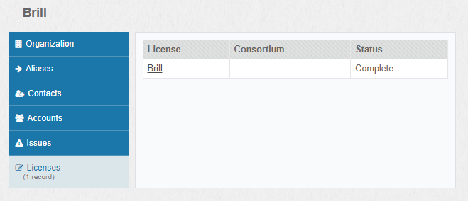

Slide 20
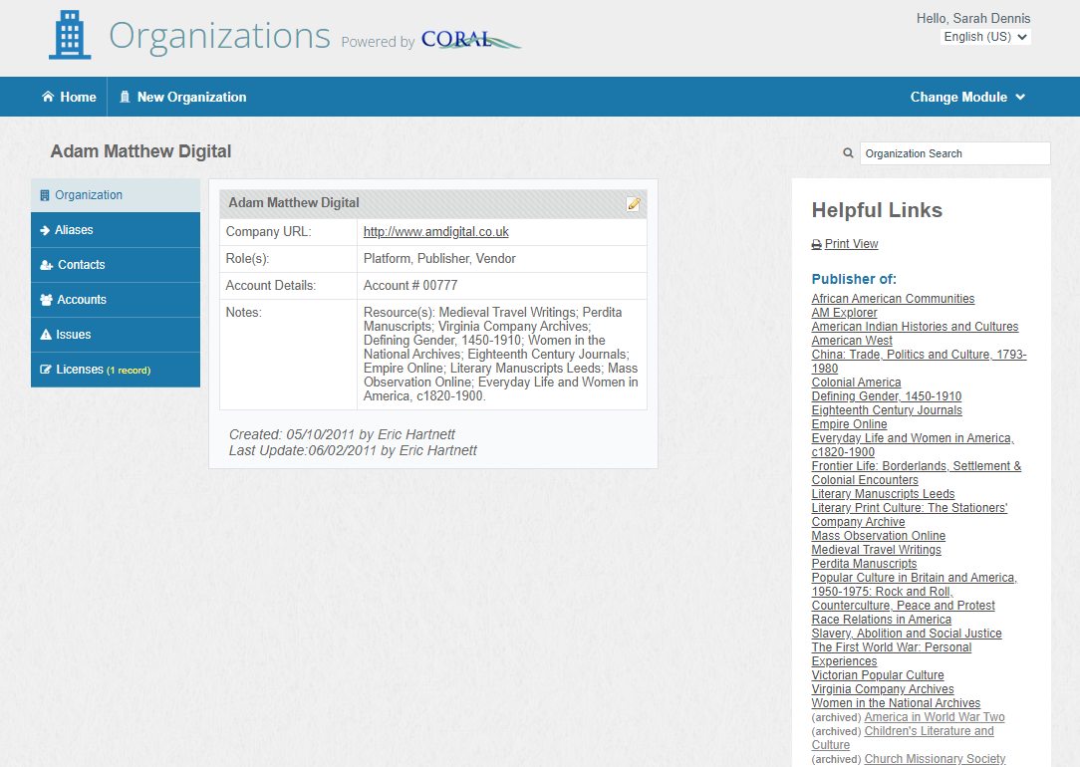

Slide 21
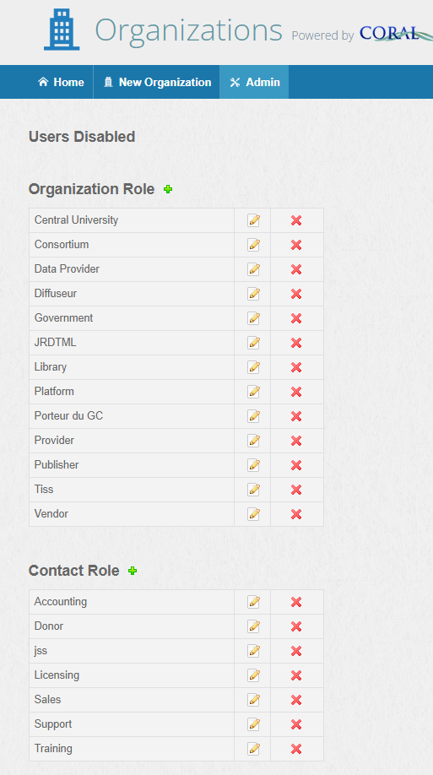
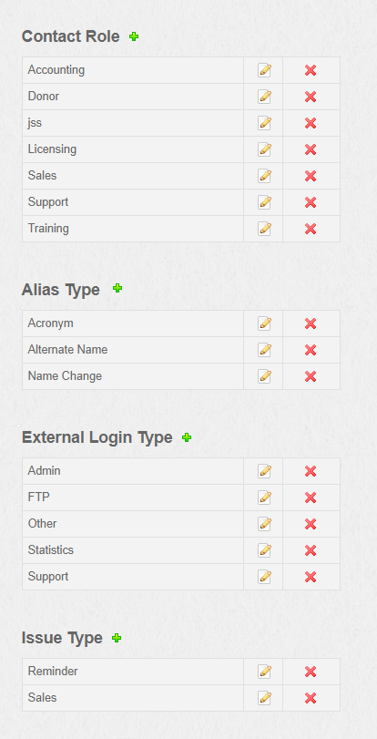

Slide 22
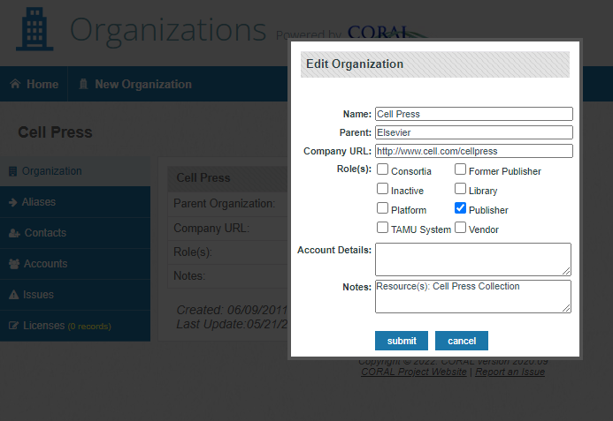
Parent - Child Relationships
Relationship formed on the Child side.

Slide 23
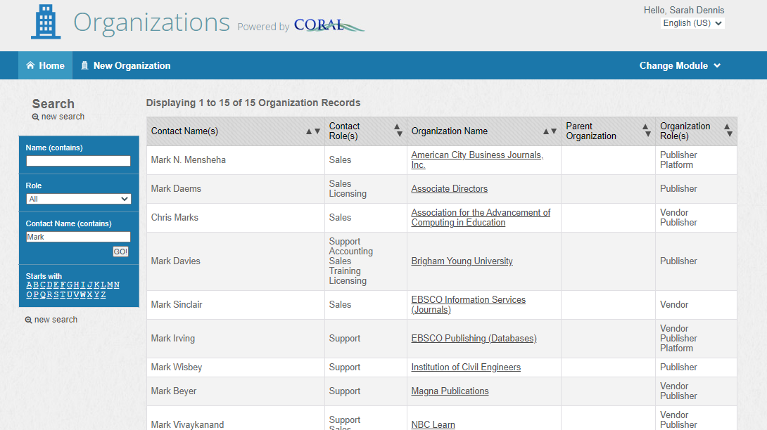
Contact Name search results for “Mark”.

Slide 24
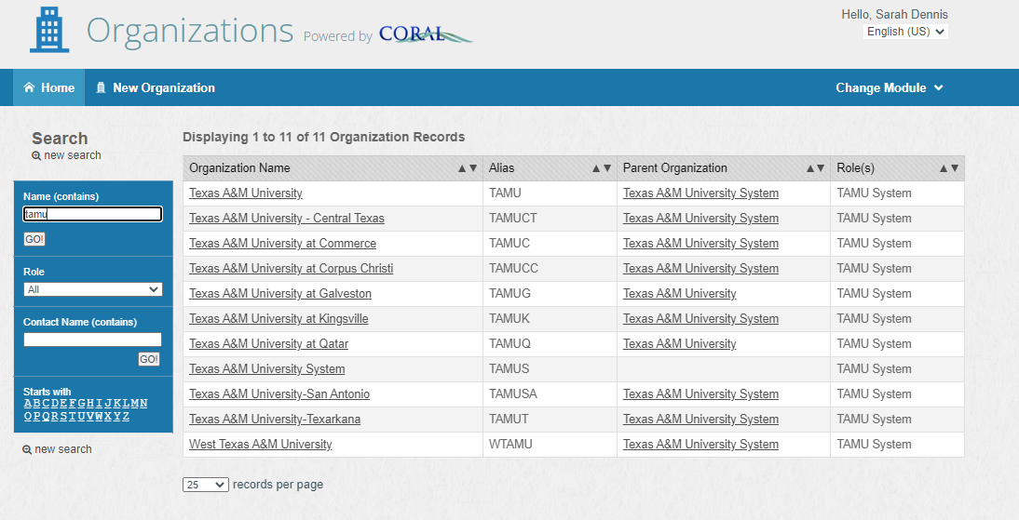
Our Organization Records for our multi-site system.

Slide 25
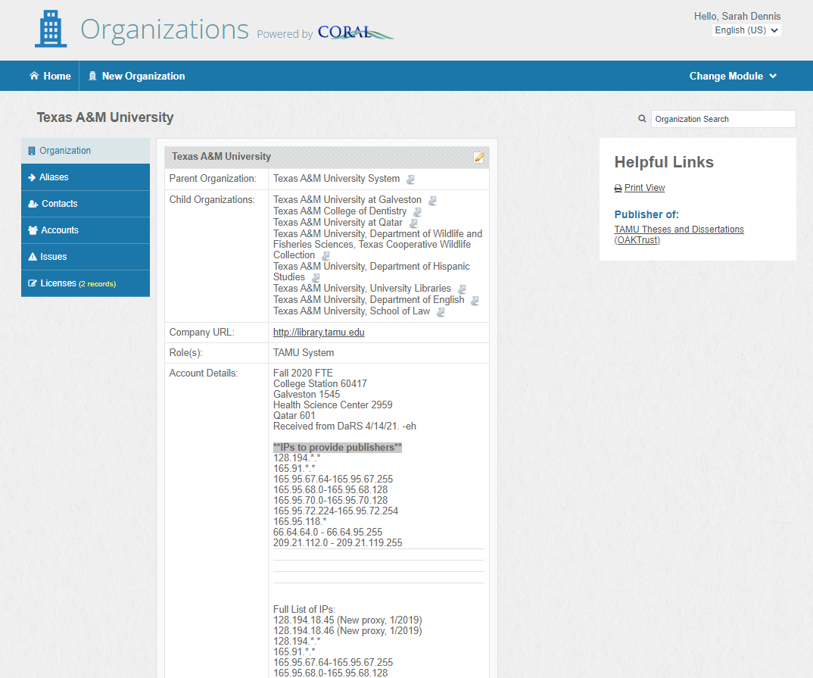
Example University Organization Record
Parent - Child Relationship
Contacts
Shows “Publisher of”
IPs
FTE
Notes

Slide 26
Conclusions

Slide 27
Thank You!
By Sarah Dennis

